Slide 1

CYZ’S SPORT EXERCISES
~~~

Slide 2
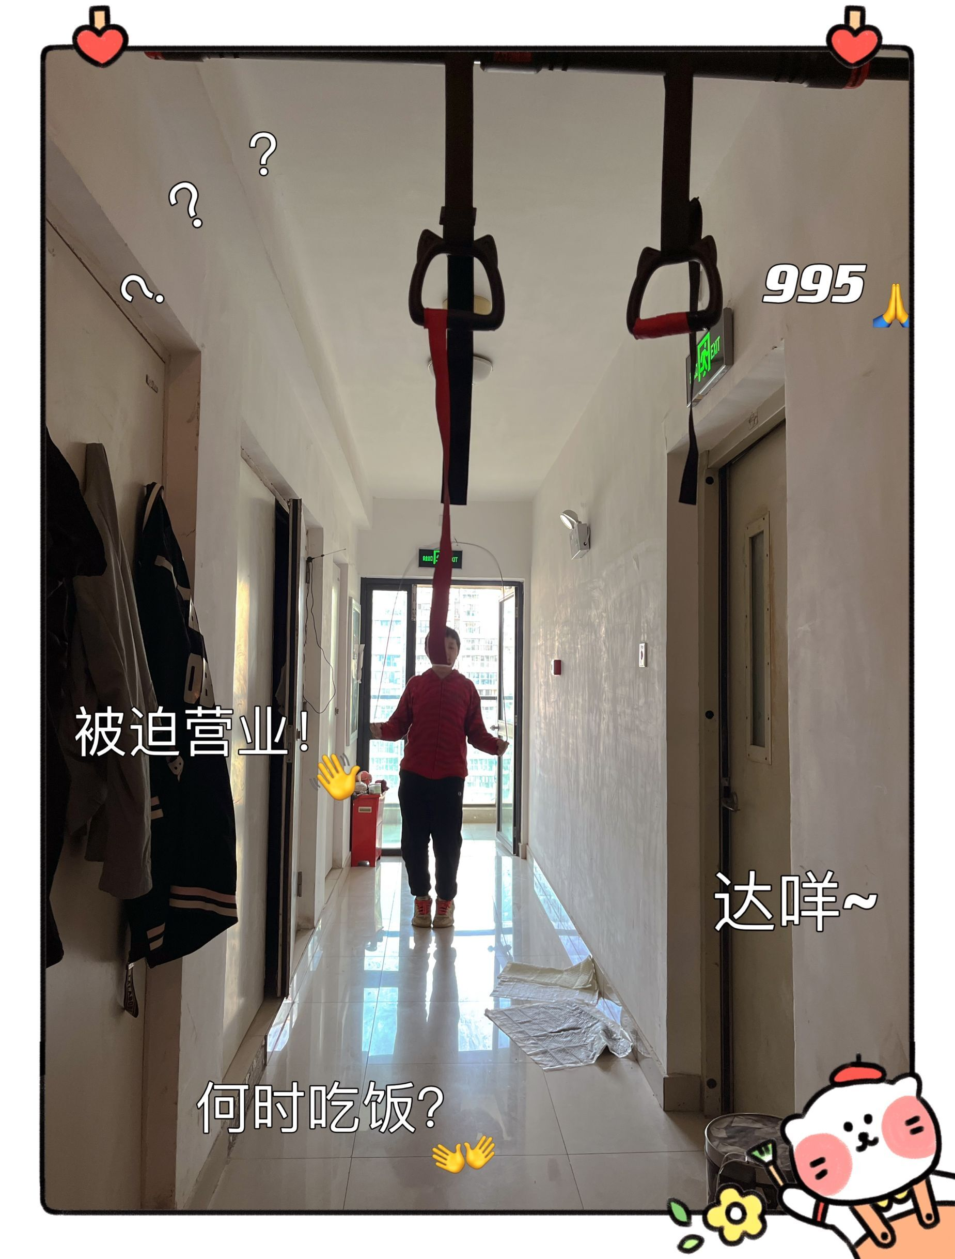

Slide 3
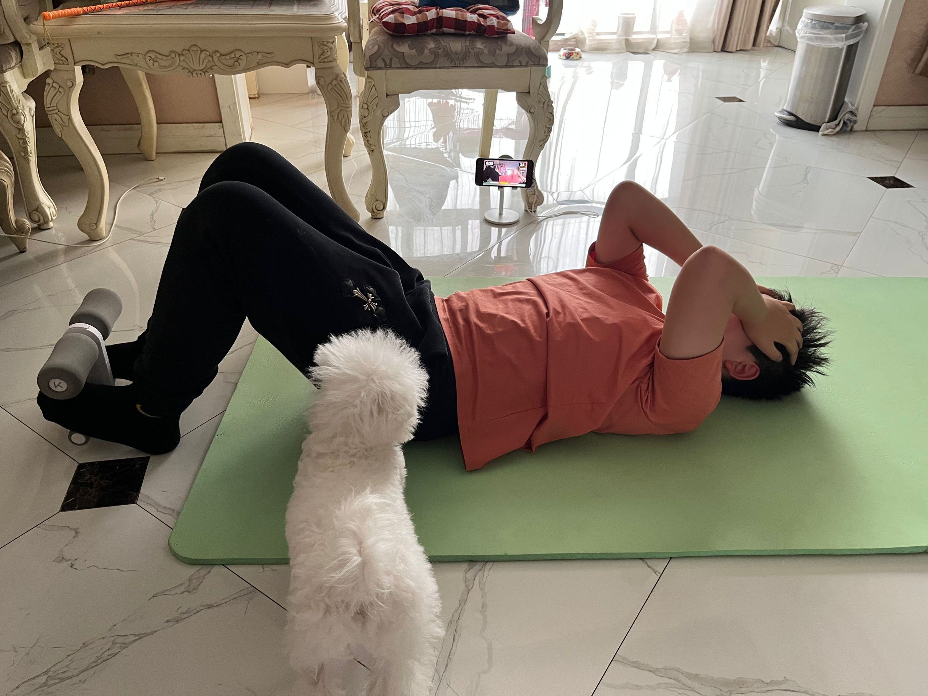
空白演示
单击输入您的封面副标题

Slide 4
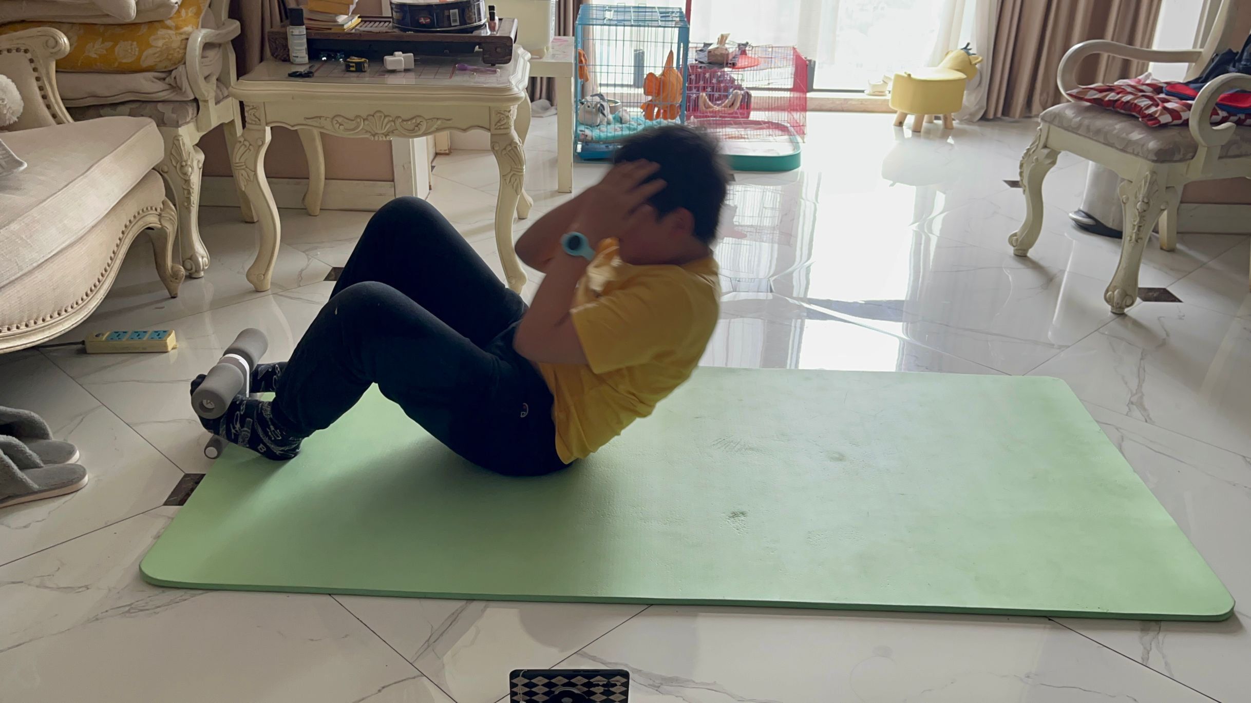

Slide 5
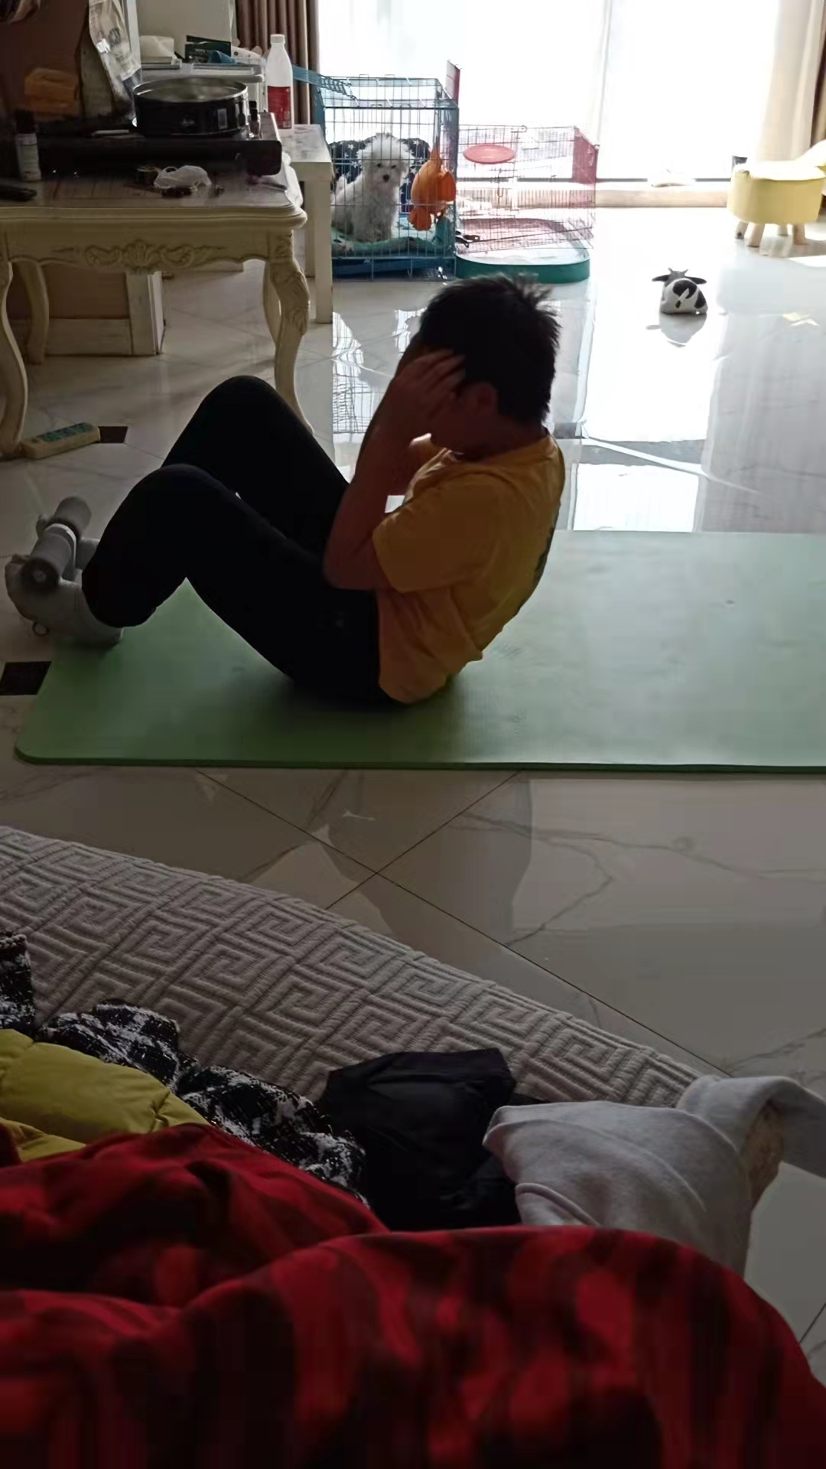

Slide 6
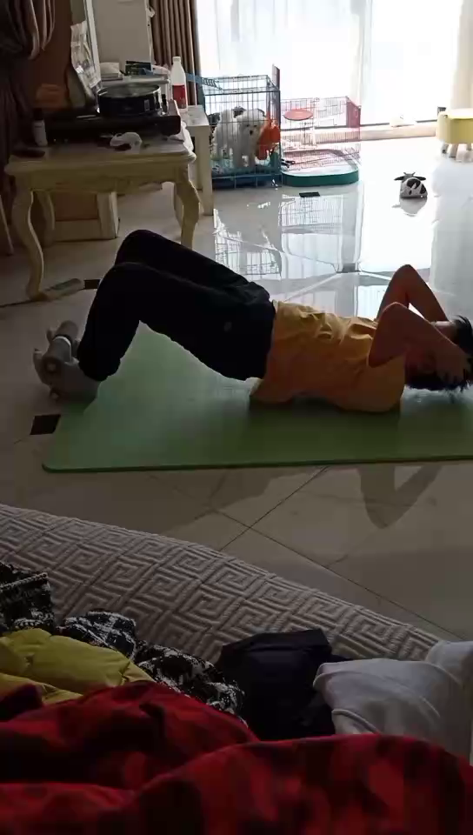

Slide 7
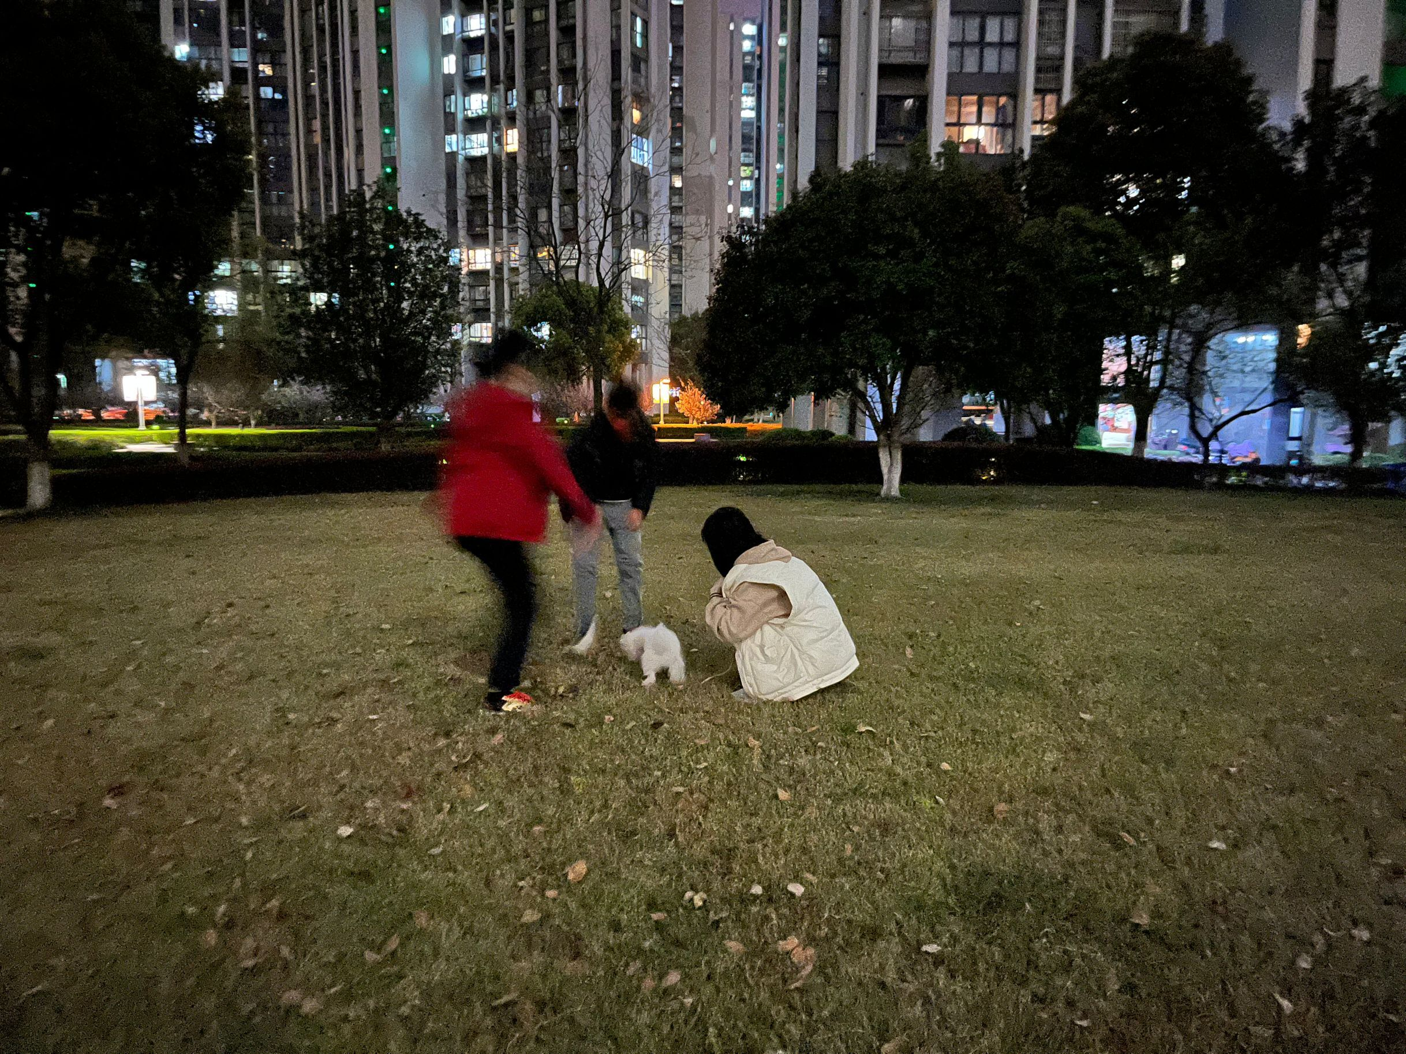

Slide 8
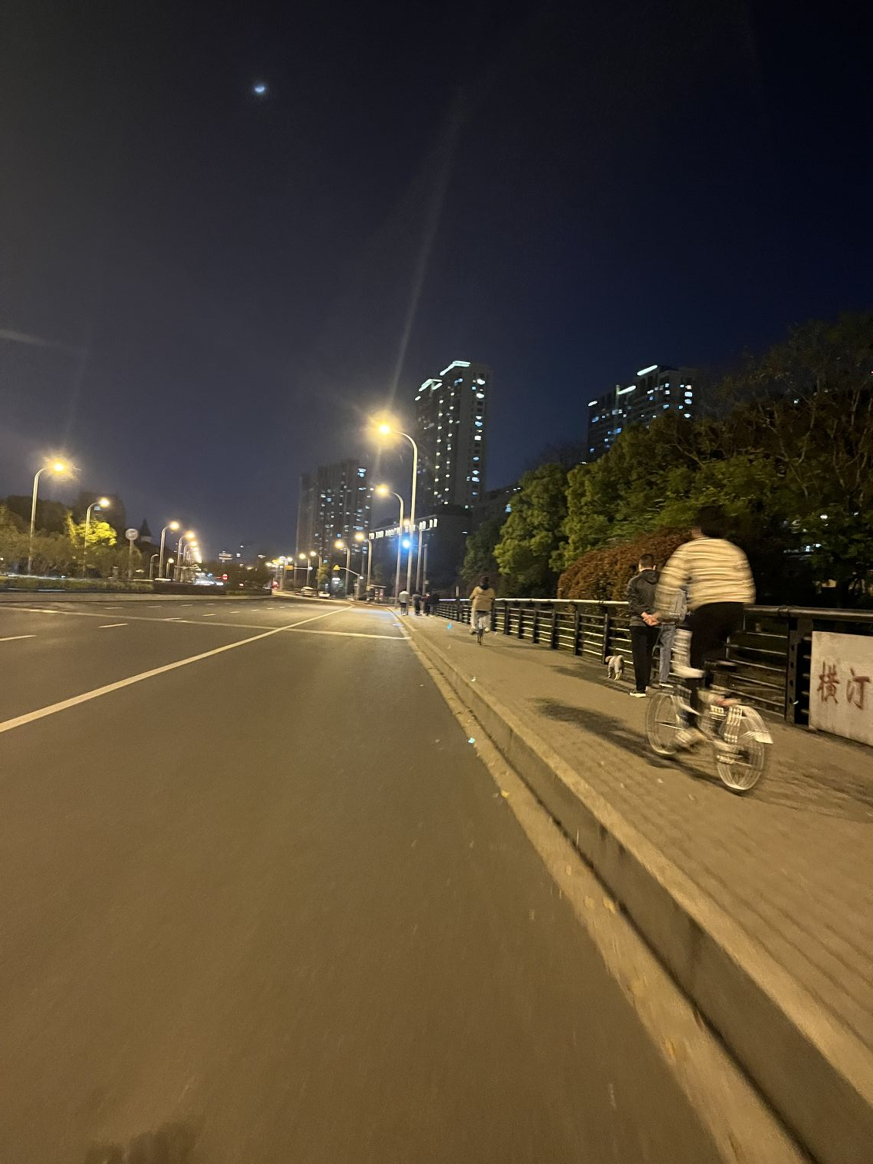

Slide 9


Slide 10
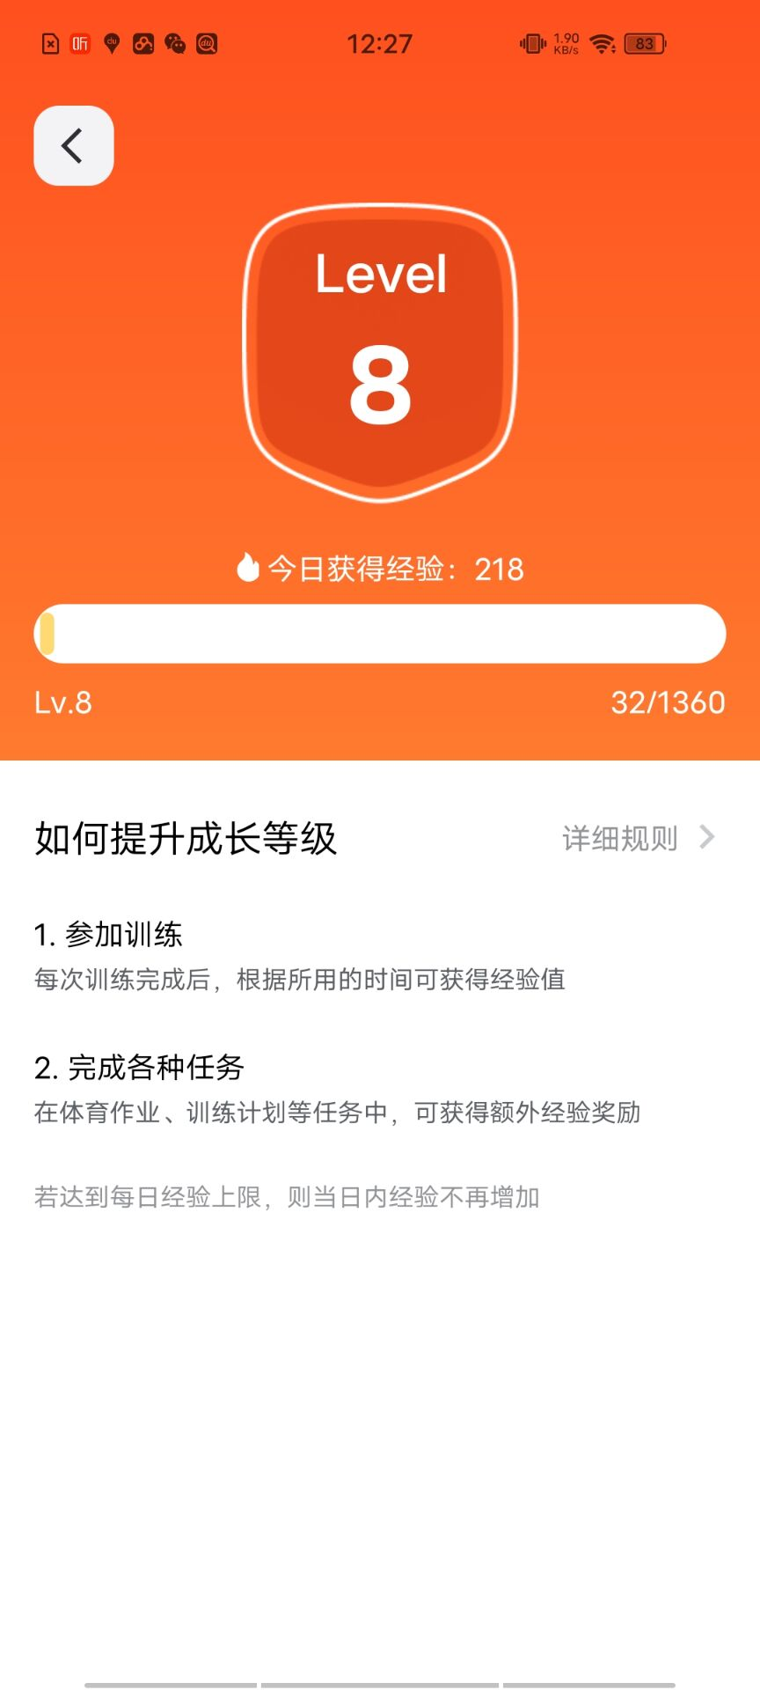

Slide 11
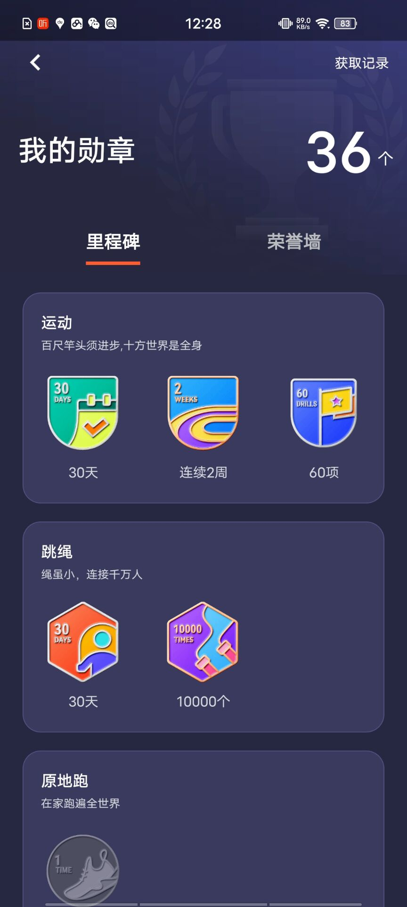

Slide 12


Slide 14
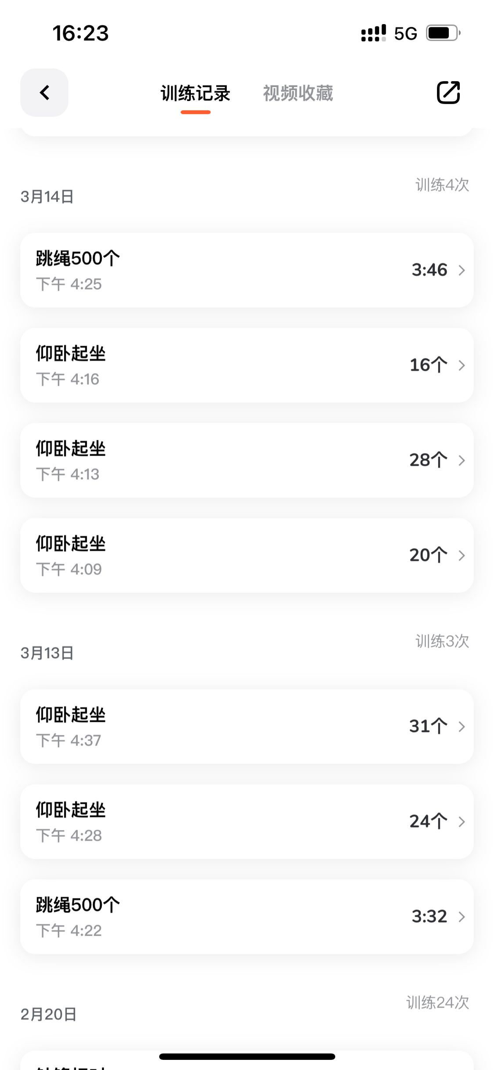

Slide 16
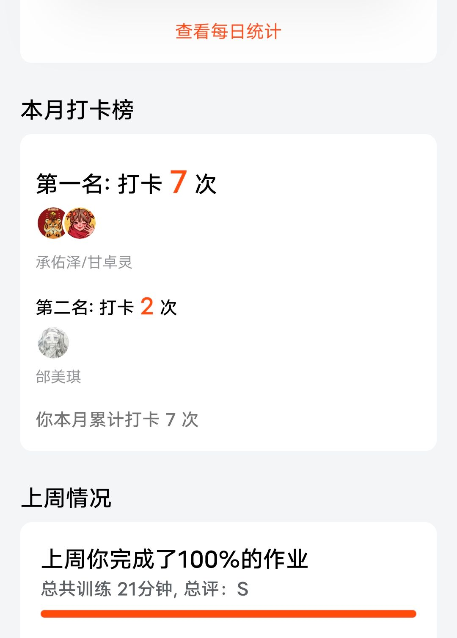

Slide 17
thank you
thank you
thank you
thank you
thank you
thank you
thank you
thank you
thank you
thank you
thank you
thank you
thank you
thank you
thank you
thank you
thank you
thank you
thank you
thank you
thank you
thank you
thank you
thank you
thank you
thank you
thank you
thank you
thank you
thank you
thank you
thank you
thank you
thank you
thank you
thank you
thank you
thank you
thank you
thank you
thank you
thank you
thank you
thank you
thank you
thank you
thank you
thank you
thank you
thank you
thank you
thank you
thank you
thank you
thank you
thank you
thank you
thank you
thank you

